Slide 1

Telecommunications: Customer Churn Prediction
Project Presentation on:
Customer Churn Prediction for Telecommunication Companies with Churn Dataset
Presentation By:
Penumatsa Seetaramaraju V L Niladriraju
Pankaj Naganath Salunkhe
Natta Veera Bala Kishore
Shubham Sanjay Somvanshi
Sri Krishna Chaitanya Ogirala
Mhaske Shrikant Chandrakant

Slide 2
Table of Contents:
1. Introduction
3. Feature Engineering
5. Deployment
2. EDA
4.Model Building & Evaluation
6. Conclusion

Slide 3
1. Introduction
Business Objective:
Telecom companies face high annual churn rates, exceeding 10%.
The goal is to predict customer churn probability based on customer features.
Customer Churn Prediction:
Customer churn is defined as when customers or subscribers discontinue doing business with a firm or service.
Telecom churn rates range from 15-25% due to intense competition.
Retaining existing customers is more cost-effective than acquiring new ones.
Predicting high-risk churn customers is essential.
Holistic customer view across various channels is crucial.
Addressing churn can lead to market preservation and growth.
Project Focus - Predictive Customer Churn:
Our project's primary focus is predicting customer churn.
Utilizing data analysis to identify early churn indicators.

Slide 4
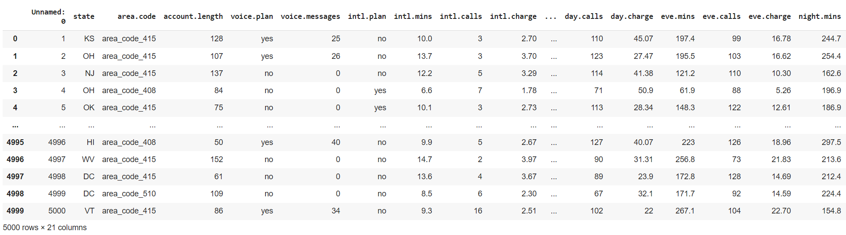
Churn.csv
Data Set Details:
Each row corresponds to a client of a telecommunications company.
information about the type of plan.
minutes, they have talked.
charge they pay every month.

Slide 5
Churn.csv dataset variables
state: Categorical, for the 51 states and the District of Columbia.
Area.code
account.length: how long the account has been active.
voice.plan: yes or no, voicemail plan.
voice.messages: number of voicemail messages.
intl.plan: yes or no, international plan.
intl.mins: minutes customer used service to make international calls.
intl.calls: total number of international calls.
intl.charge: total international charge.
day.mins: minutes customer used service during the day.
day.calls: total number of calls during the day.
day.charge: total charge during the day.
eve.mins: minutes customer used service during the evening.
eve.calls: total number of calls during the evening.
eve.charge: total charge during the evening.
night.mins: minutes customer used service during the night.
night.calls: total number of calls during the night.
night.charge: total charge during the night.
customer.calls: number of calls to customer service.
churn: Categorical, yes or no. Indicator of whether the customer has left the company (yes or no).

Slide 6
Steps Involved
1. Data Preparation:
Load and explore the dataset.
Handle missing values.
Convert categorical variables to numerical format.
Split data into features (X) and target variable (y).
2. Exploratory Data Analysis:
Analyze the distribution of the target variable (churn).
Explore feature-target relationships with visualizations and stats.
3. Feature Selection/Engineering:
Select relevant features.
Create new features if needed.
4. Model Selection and Training:
Choose appropriate ML algorithms (e.g., logistic regression, decision trees).
Train models on training data.
5. Model Evaluation:
Assess model performance using metrics (accuracy, precision, recall, etc.).
Employ cross-validation for generalization.
6. Hyperparameter Tuning:
Optimize model hyperparameters.
Use techniques like grid search or random search.
7. Optional: Model Interpretation:
Understand feature contributions (if applicable).
8. Model Deployment:
Deploy the trained model (e.g., in a web app or API).

Slide 7
Feature Engineering
Definition:
Feature engineering is a critical process in machine learning that involves creating, selecting, and transforming variables from raw data to improve model performance.
Challenges:
Balancing act: It requires finding the right balance between relevant features and complexity.
Expertise: Feature engineering demands domain knowledge to identify meaningful predictors.
Time-consuming: Creating and testing various features can be time-intensive.
Steps:
Data Extraction:
Collect relevant data from various sources, ensuring it covers essential aspects.
Feature Creation:
Transform raw data into meaningful features that help models understand relationships and patterns.
Examples: Aggregations (e.g., averages, sums), interactions (e.g., product of two variables), scaling, and encoding categorical data.
Feature Selection:
Choose the most informative features and eliminate irrelevant ones to simplify models and prevent overfitting.
Feature Storage:
Organize and store engineered features for easy access during model training and deployment.
Importance: Effective feature engineering can:
Enhance model accuracy by capturing essential information.
Reduce dimensionality, improving model training speed.
Provide insights into relationships between variables.

Slide 8
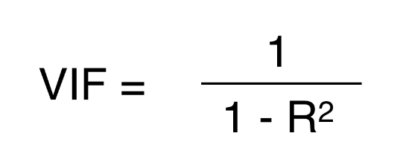
Methods used and Finding Multicollinearity Using VIF values for Features
Importantce:
Identifying multicollinearity is crucial for robust model building and accurate predictions.
Steps:
Normalize the Dataset: Ensure all features are on the same scale to prevent magnitude-related issues.
Feature Selection:
Use Ordinary Least Squares (OLS) to find important features.
Calculate p-values to determine feature correlations.
Select 7 Important Features: Narrow down the features essential for churn prediction.
VIF Calculation:
Calculate (VIF) for each selected feature.
VIF quantifies how much a feature's variance is inflated due to multicollinearity.
Interpret VIF Values:
VIF of 1: No multicollinearity (ideal).
VIF < 5: Moderate multicollinearity.
VIF > 5: High multicollinearity (requires attention).
Re-evaluate Features:
Use Select K Best Method to refine feature selection based on VIF results.
Formula:

Slide 9
Feature Engineering techniques & Models Used
Ordinary Least Square Method (OLS):
Definition: Used for linear regression, OLS estimates model parameters by minimizing the sum of squared residuals between actual and predicted values.
Select K Best Method:
Usage: Selects the top-k features based on specific scoring functions.
For Regression: Utilizes functions like f_regression.
For Classification: Employs chi2 and f_classif.
Logistic Regression:
Purpose: Effective for binary classification tasks like churn prediction.
Advantages: Easy to interpret and serves as a baseline model.
Decision Trees:
Characteristics: Capture complex non-linear relationships in data.
Versatile: Handle both numerical and categorical features.
Consideration: Prone to overfitting, requiring careful tuning.
Random Forest:
Ensemble Method: Combines multiple decision trees for improved accuracy.
Advantages: Robust and suitable for various data types.
Overfitting Control: Effective in reducing overfitting.
Gradient Boosting:
Boosting Algorithms: Includes XGBoost, LightGBM, and CatBoost.
Strengths: Robust handling of imbalanced datasets and complex patterns.
Ensemble Power: Combines weak learners (often decision trees) to create strong predictive models.

Slide 10
Deployment --- Streamlit App
Model Deployment:
Definition: Model deployment involves integrating a machine learning model into a production environment to take inputs and provide outputs.
Streamlit App:
Streamlit: An open-source Python library.
Purpose: Create interactive web applications for data visualization and exploration with minimal coding.
Benefits:
User-friendly:
Requires minimal web development knowledge.
Speed:
Quickly turn data scripts into shareable web apps.
Rapid Prototyping:
Build and deploy data apps effortlessly.
Share Insights:
Easy tool for sharing data insights.
Streamlit simplifies the process of creating and sharing data-driven web applications, making it an excellent choice for deploying machine learning models and sharing data insights with a broader audience.

Slide 11
Streamlit App
Creating and Deploying a Streamlit App:
Install Streamlit:
Ensure Streamlit is installed on your system.
Create Your App Script:
Write your Streamlit app script in Python (e.g., app.py).
Import Necessary Libraries:
Import Streamlit and other required libraries.
Add App Content:
In app.py, include text, data visualizations, widgets, and interactive elements.
Load and Process Data:
If applicable, load and process data in various formats (e.g., CSV, JSON).
Create Interactive Widgets:
Utilize Streamlit's widgets (e.g., sliders, select boxes) to enhance user interaction.
Perform Data Visualization:
Create data visualizations using popular plotting libraries (e.g., Matplotlib, Plotly).
Run the App Locally:
Save app.py and run the app locally with the command: streamlit run app.py.
Test and Iterate:
Interact with the app, ensuring it meets expectations.
Iterate and refine as needed for a better user experience.
Deployment:
Once satisfied, deploy the app to a hosting platform or cloud service (e.g., Heroku, AWS, PythonAnywhere) for broader accessibility.

Slide 12
2. Exploratory Data Analysis (EDA)
Definition:
EDA is a crucial technique in data science for extracting essential features and trends used in machine learning and deep learning models.
Purpose:
EDA helps data scientists:
Analyze and investigate datasets.
Summarize key dataset characteristics.
Discover patterns, anomalies, and relationships.
Test hypotheses and check assumptions.
Components of EDA:
Understanding Your Variables:
Gain insights into dataset variables, their types, and distributions.
Identify potential outliers or missing values.
Cleaning Your Dataset:
Preprocess data by handling missing values, outliers, and duplicates.
Ensure data consistency and quality.
Analyzing Relationships Between Variables:
Explore interactions and dependencies between variables.
Employ data visualization methods to visualize relationships.
Historical Significance:
EDA was pioneered by American mathematician John Tukey in the 1970s.
It remains a fundamental and widely used method for data discovery and analysis today.

Slide 13
Steps for EDA and VISUALIZATIONS & REMOVING OUTLIERS
Data Preprocessing:
Import Dataset: Begin by importing the dataset for analysis.
Rename and Drop Columns: Modify column names and remove unnecessary columns.
Check for Duplicates: Identify and handle any duplicate values in the dataset.
Gather Dataset Information: Understand dataset characteristics and data types.
Check for Null Values: Detect and replace missing values with feature means.
Visualizations and Outlier Handling:
Histograms: Visualize data distribution for most features (excluding categorical and state-related columns).
Boxplots: Identify and handle outliers using the Interquartile Range (IQR) method.
Distribution Plots: Confirm the effectiveness of outlier removal.
Histograms (Post-Outlier Removal): Check if features approximate a normal distribution.
Boxplot (Post-Outlier Removal): Verify the success of outlier removal.
Bar Plots:
Examine the number of records based on Area Code.
Analyze Churn Rate by State.
Evaluate Churn Rate based on Area Code.
Investigate Churn Rate based on Voice Plan.
Explore Churn Rate based on International Plan.
Correlation Matrix: Assess feature correlations with the target variable (Churn).

Slide 14
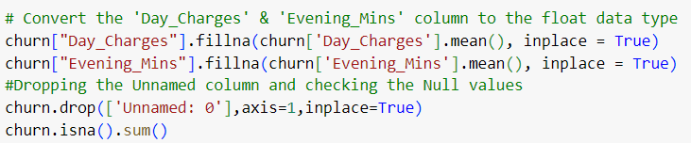
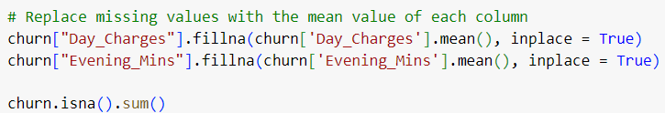
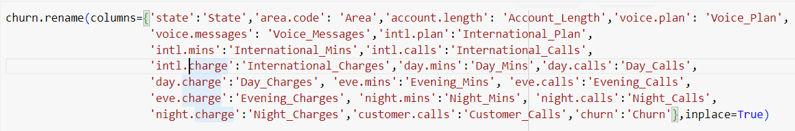
Working on Dataset and preparing data
Convert Object Columns to Numeric:
Handling Null Values:
Drop Unnamed Column:
Rename Columns:

Slide 15
Graphical Representation
Histogram and Boxplot Initial Analysis:
Visualized histograms and boxplots to understand data distributions and identify initial outliers.
Outlier Detection and Treatment:
Detected outliers individually in each column.
Applied appropriate outlier treatment techniques (e.g., IQR method) to handle outliers for improved data quality.
Histogram and Boxplot (Post-Outlier Treatment):
Visualized histograms and boxplots again to assess the impact of outlier treatment on data distributions.
Bar Plots for Churn Distribution:
Examined churn distribution with respect to:
Area code
International Plan
Voice Plan
State
Bar Plot for Count of Records vs. Area Code:
Analyzed the count of records based on area code.
Heatmap Correlation:
Utilized a heatmap to visualize feature correlations, providing insights into relationships between variables and their influence on churn.

Slide 16
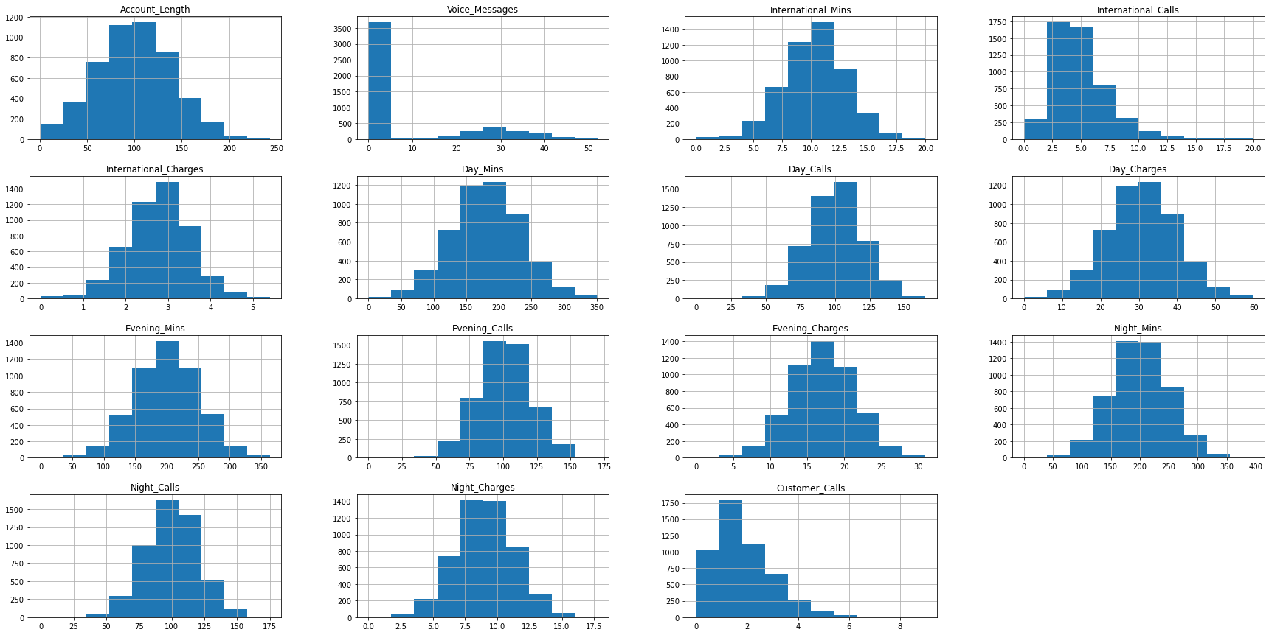
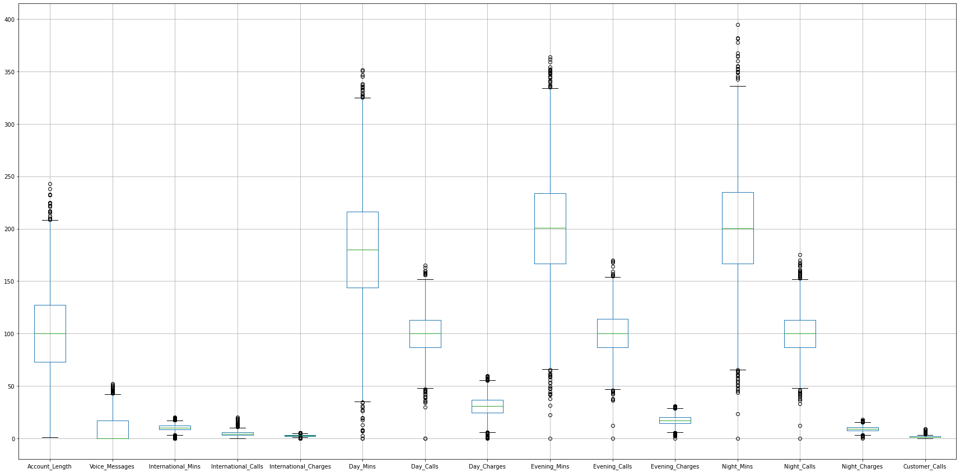
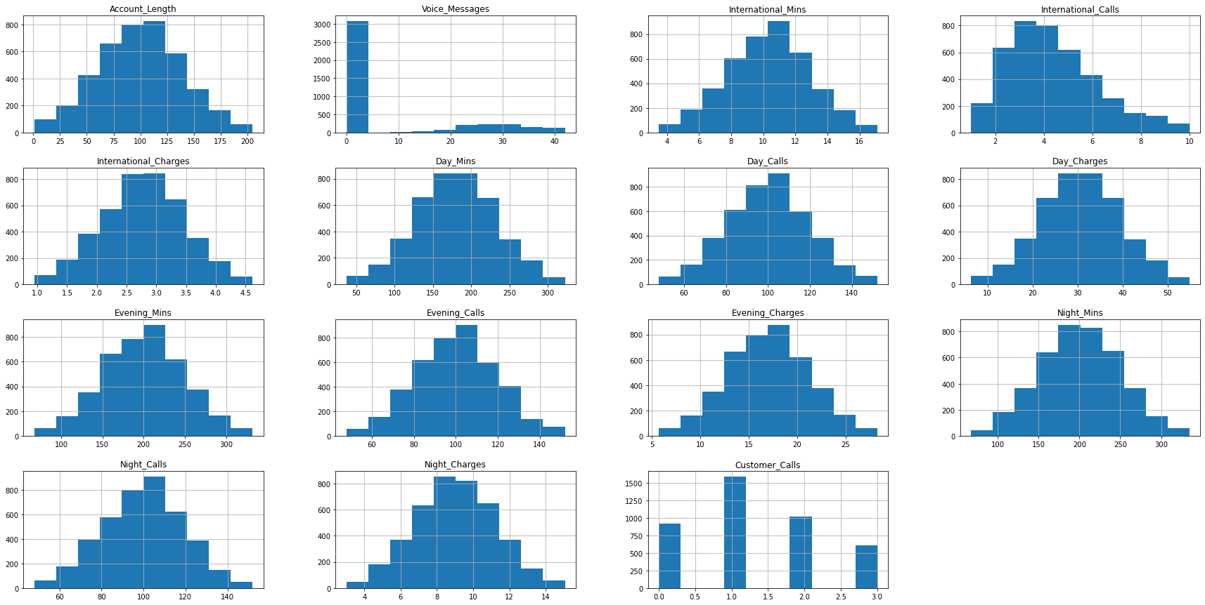
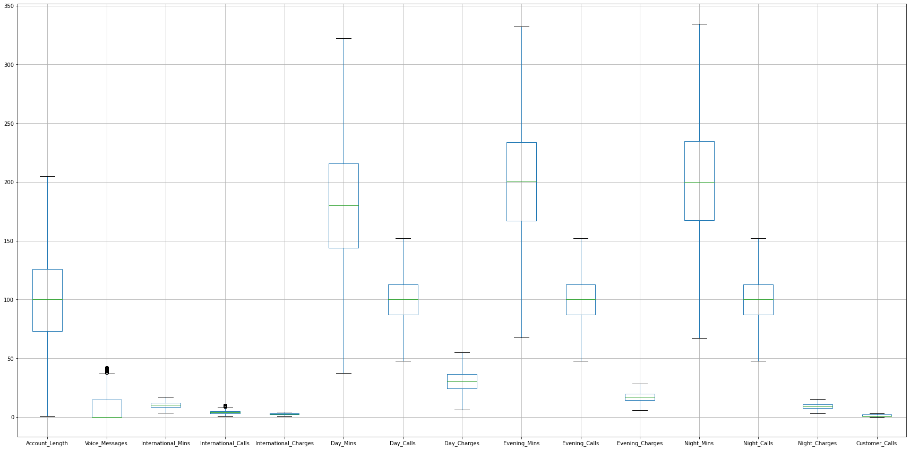
Histogram and Box plots before treating outliers
Histogram and Box plots after treating outliers

Slide 17
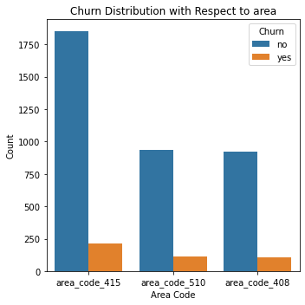
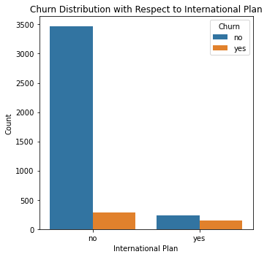
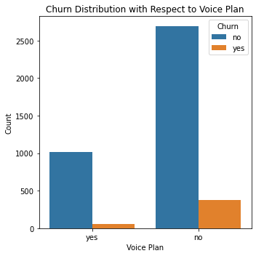
Churn Distribution Bar plots

Slide 18
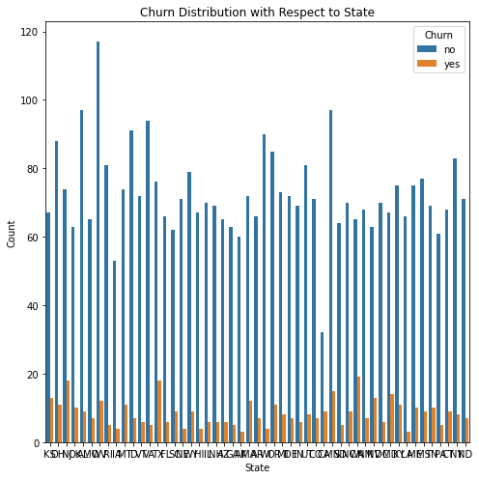
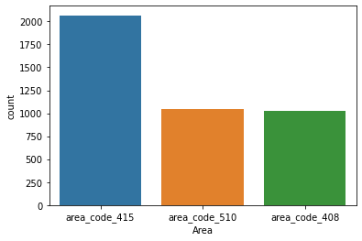
State Churn Distribution and Bar plots for Counts of Records Vs Area
Count of Records vs Area - Bar Plot After Removing Outliers

Slide 19
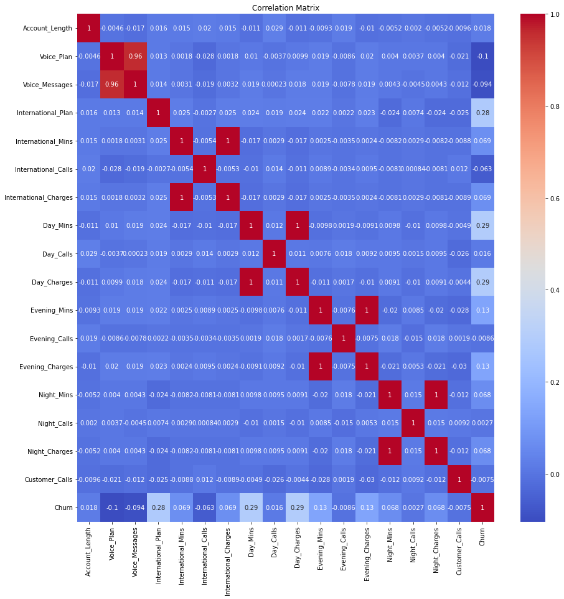
Heat map Correlation

Slide 20
Key Insights from Data Preprocessing and Visualization:
Data Cleanup:
Identified numeric and object data types.
Removed unnecessary columns, enhancing dataset cleanliness.
Data Conversion and Handling Null Values:
Converted "Day_Charges" and "Evening_Mins" columns to numeric data types.
Handled null values by replacing them with feature means, ensuring data completeness.
Outlier Detection and Treatment:
Detected outliers in multiple variables.
Applied outlier treatment techniques to enhance data quality.
Data Visualization:
Utilized histograms and box plots to visually explore data distributions and outliers.
Churn Distribution Analysis:
Explored churn distribution with respect to various factors, including State, Area code, Voice Plan, and International Plan.
Count of Records vs. Area:
Investigated the distribution of records based on area, providing insights into data distribution.
Correlation Analysis:
Employed a heatmap to assess feature correlations, revealing relationships between variables.

Slide 21
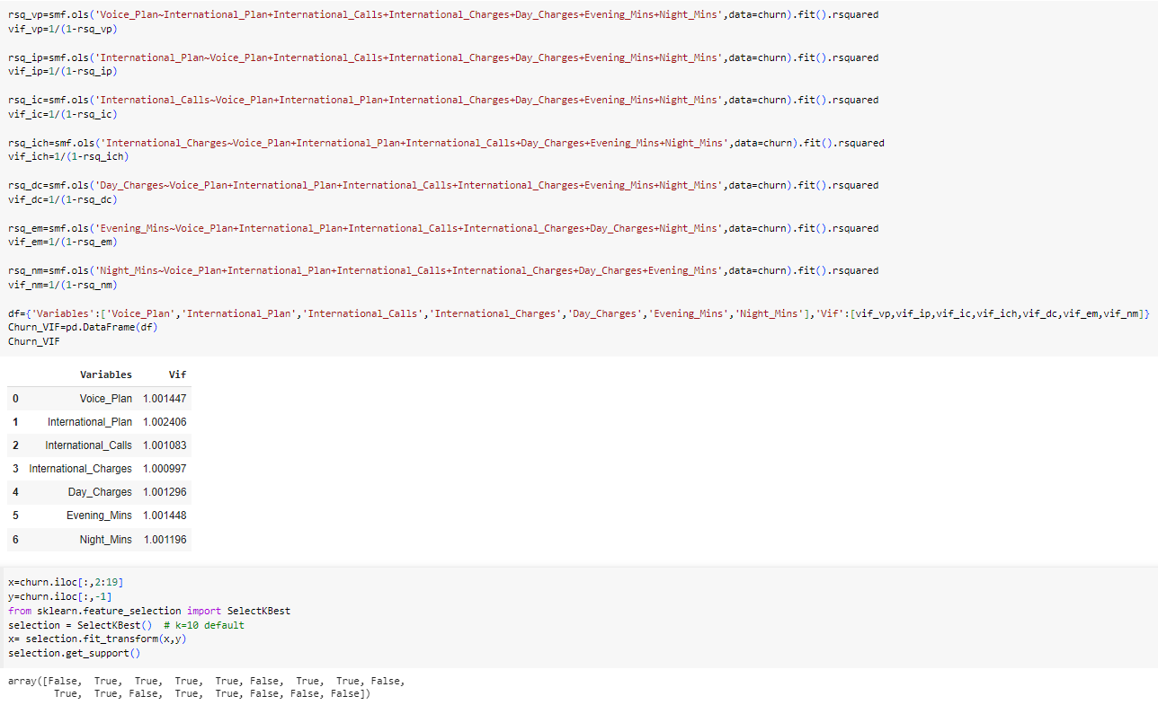
3. Feature Engineering
Code for Selection of Features

Slide 22
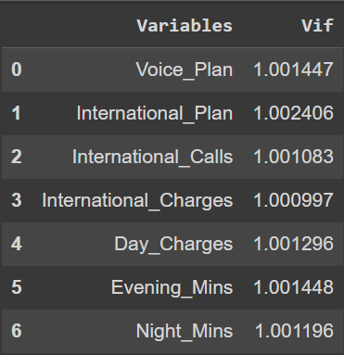
Features Extraction
Vif values for variables
Normalizing The Dataset.
Finding Important Features Using Ordinary Least Square Method.
Finding P[t] Values for the features who are having Correlation using Ordinary Least Square Method.
Finalizing 7 Features which are important for Prediction of Churn.
Calculating VIF Values for the 7 selected Features.
Re-evaluating the Chosen Features using Select K Best Method.

Slide 23
Key Insights from Feature Selection and Evaluation:
1. Data Normalization:
Ensured data consistency by normalizing the dataset, aligning features on the same scale.
2. Feature Engineering Methods:
Employed feature engineering techniques, including Ordinary Least Square (OLS) and Select K Best, to identify important features and their correlations.
3. OLS Method for Correlation Analysis:
Utilized the Ordinary Least Square (OLS) method to calculate p-values, which helped identify features with significant correlations to churn.
4. Finalization of 7 Important Features:
Selected and finalized 7 essential features crucial for predicting churn.
5. VIF Calculation:
Computed Variance Inflation Factor (VIF) values for all 7 selected features to assess multicollinearity.
6. Re-evaluation with Select K Best:
Reassessed the importance of the chosen features using the Select K Best method, confirming their relevance for churn prediction.

Slide 24
4. Model Building and Evaluation
Model Building:
Definition:
Building an ML model involves creating a mathematical representation based on training data.
Data Splitting:
Split the dataset into two sets: a training set and a testing set (e.g., 80:20 or 70:30 ratio).
Algorithm Selection:
Choose appropriate supervised or unsupervised algorithms based on data nature and desired business outcomes.
Model Evaluation:
Definition:
Model evaluation is the process of assessing a machine learning model's performance and understanding its strengths and weaknesses using various evaluation metrics.
Steps in Model Evaluation:
Data Splitting:
Split the dataset into training and testing subsets to evaluate model performance.
Smoothing Technique:
Apply smoothing techniques to address dataset imbalances and enhance model stability.
Classification Models:
Apply various classification algorithms, such as Logistic Regression, Random Forest Classification, Decision Tree Classification, and Gradient Boosting, to improve predictive accuracy.
Accuracy Evaluation:
Build a table to record and compare the accuracies achieved by different models.

Slide 25
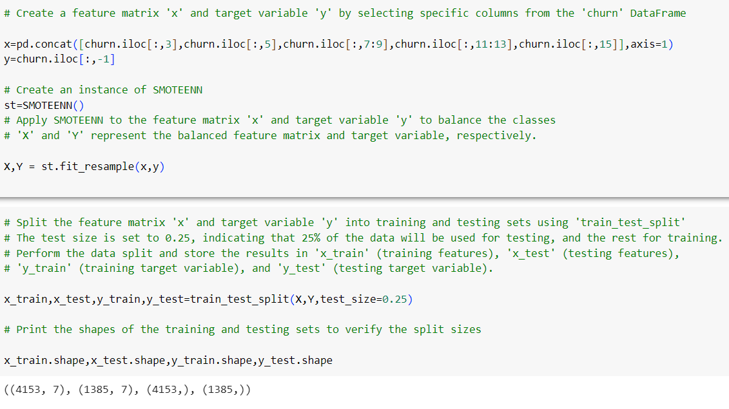
Code for Creating Train and Test sets to build Model

Slide 26
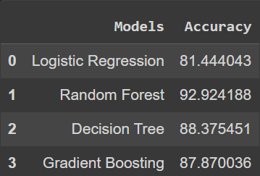
Models Used and Accuracy
Logistic Regression:
A simple yet effective model for binary classification.
Accuracy: 81%
Decision Trees:
Able to capture complex non-linear relationships in the data.
Easy to visualize and versatile with numerical and categorical features.
Accuracy: 92%
Random Forest:
An ensemble method that combines multiple decision trees for improved accuracy and reduced overfitting.
Robust and adaptable to various data types.
Accuracy: 88%
Gradient Boosting (e.g., XGBoost, LightGBM, CatBoost):
Powerful techniques that create strong predictive models by combining weak learners, often decision trees.
Effective for handling imbalanced datasets and capturing complex patterns.
Accuracy: 87%

Slide 27
Key Classification Metrics:
1. Accuracy:
Measures the proportion of correct predictions out of the total predictions.
Formula: (Number of Correct Predictions) / (Total Number of Predictions)
Indicates overall model correctness.
2. Precision:
Measures the proportion of correct positive predictions out of all positive predictions.
Formula: (True Positives) / (True Positives + False Positives)
Focuses on the accuracy of positive predictions.
3. Recall (Sensitivity or True Positive Rate):
Measures the proportion of correct positive predictions out of all actual positives.
Formula: (True Positives) / (True Positives + False Negatives)
Focuses on the model's ability to identify actual positives.
4. F1 Score:
Balances precision and recall by calculating their harmonic mean.
Range: 0 (worst) to 1 (best).
Indicates the model's overall accuracy and balance between precision and recall.
5. Confusion Matrix:
Provides a tabular representation of actual vs. predicted values.
Helps assess model performance but is not considered a metric itself.

Slide 28
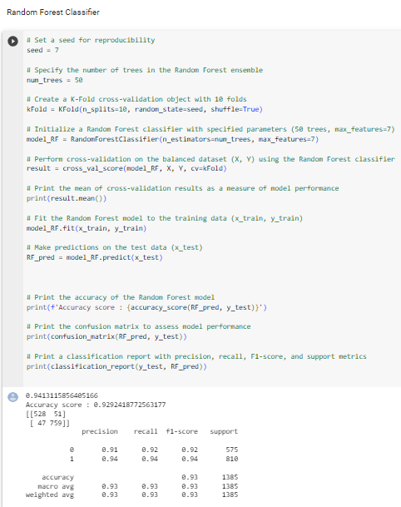
Random Forest Code
Accuracy for Random Forest is 92.92 %.
Which is high compared to other models.
Also we have Confusion matrix score:
We also have good Precision, Recall, f1-score.
Random Forest Model is used for predicting the churn and deployed to app.

Slide 29
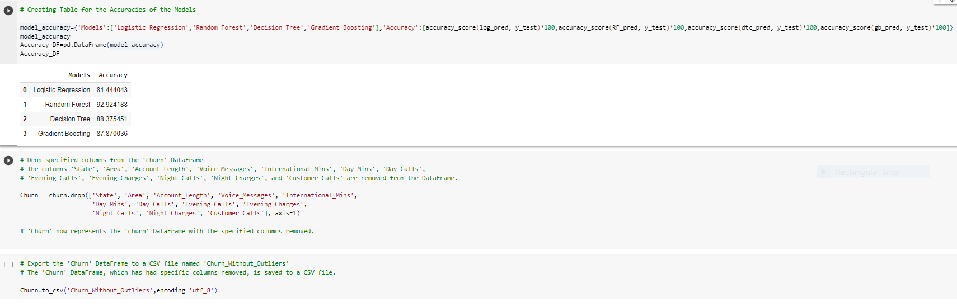
Insights
Model Evaluation:
Applied various models, including Logistic Regression, Random Forest, Decision Tree, and Gradient Boosting, to both training and test datasets.
Compared model accuracies to assess their performance.
Model Selection:
Identified Random Forest as the model with the highest accuracy rate.
Feature Selection:
Retained only the 7 important features, discarding others for deployment.
Data Preparation for Deployment:
Created a clean dataset containing the 7 selected features, without outliers.
Ready for Deployment:
The dataset is now prepared and ready for deployment, potentially for use in a Streamlit application

Slide 30
5. Deployment
Machine Learning Model Deployment:
Deployment is the process of placing a finished machine learning model into a live environment where it can be used for its intended purpose.
Key Aspects of Model Deployment:
Model Development:
Models are developed, trained, and tested with carefully prepared datasets.
Model Selection:
Only a few models meet desired objectives, representing a significant resource investment.
Planning and Preparation:
Deployment requires meticulous planning and preparation for success.
Deployment Process:
Moving the Model:
Transfer the model to its deployed environment with the necessary hardware resources and data sources.
Integration:
Integrate the model into existing processes or make it accessible to end users through APIs or software.
User Training:
Train end users on how to activate the model, access its data, and interpret its outputs.
Final Thoughts:
Deploying a machine learning model is a complex process that involves not only technical considerations but also user training and integration into existing workflows. Careful planning is crucial for a successful deployment.

Slide 31
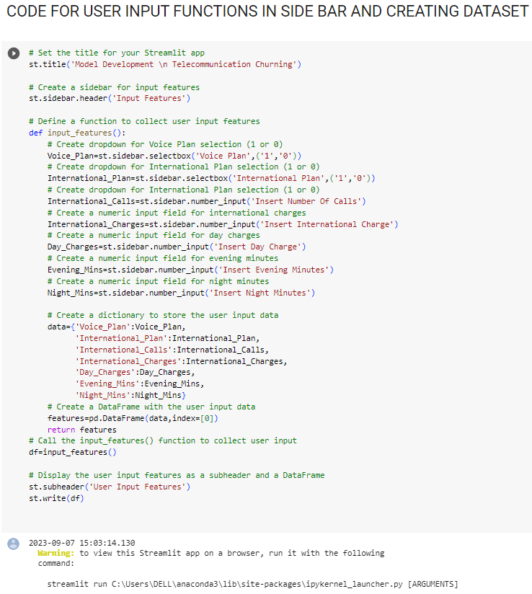
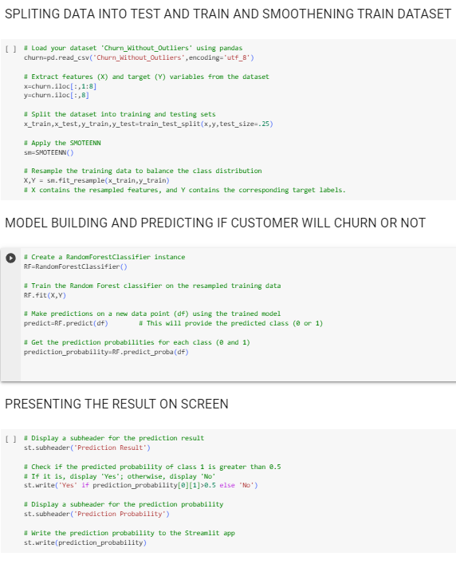
Code For Deployment

Slide 32
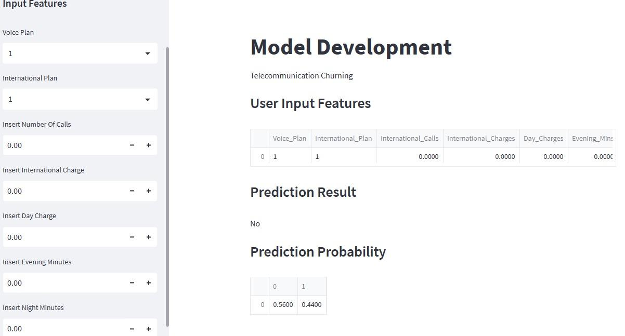
Deployment App
Deployment Process and Results:
Automatic Result Display:
The deployment code automatically displays results without a predict button.
Input Features:
Features are provided as inputs, including Voice and International Plans.
0 represents "No," and 1 represents "Yes" for these plans.
Other features are numerical data from the dataset, and in this case, they are all set to zero.
Prediction Output:
Upon execution, the model predicts the outcome.
In this specific case, the prediction is "No Churn" with a probability of 44%.

Slide 33
6. Conclusion
Objective Achievement:
Successfully achieved the objective of predicting customer churn from the "churn.csv" dataset.
Data Analysis and Visualization:
Analyzed churn distribution among variables.
Visualized data after preprocessing and cleaning the dataset.
Feature Selection:
Identified 7 important features using Ordinary Least Square and Select K Best methods.
Calculated and displayed VIF values for feature evaluation.
Model Building and Evaluation:
Built models with train and test sets for the 7 important features.
Applied Logistic Regression, Random Forest, Decision Tree, and Gradient Boosting models.
Achieved high accuracy, precision, recall, and f1-score, with Random Forest reaching 92.92%.
Deployment:
Deployed the Random Forest model using a Streamlit app.
The app allows predicting churn and provides prediction probabilities based on 7 input features.
This project successfully addressed the challenge of customer churn prediction, offering insights into feature importance and achieving high model accuracy. The deployment through the Streamlit app enables easy use and interpretation of the model's predictions.

Slide 34

Random Forest Code & Result and Accuracy comparison with for other Models
Accuracy for Random Forest is 92.92 %.
Which is high compared to other models.
Also we have Confusion matrix score:
We also have good Precision, Recall, f1-score.
Random Forest Model is used for predicting the churn and deployed to app.

Slide 35
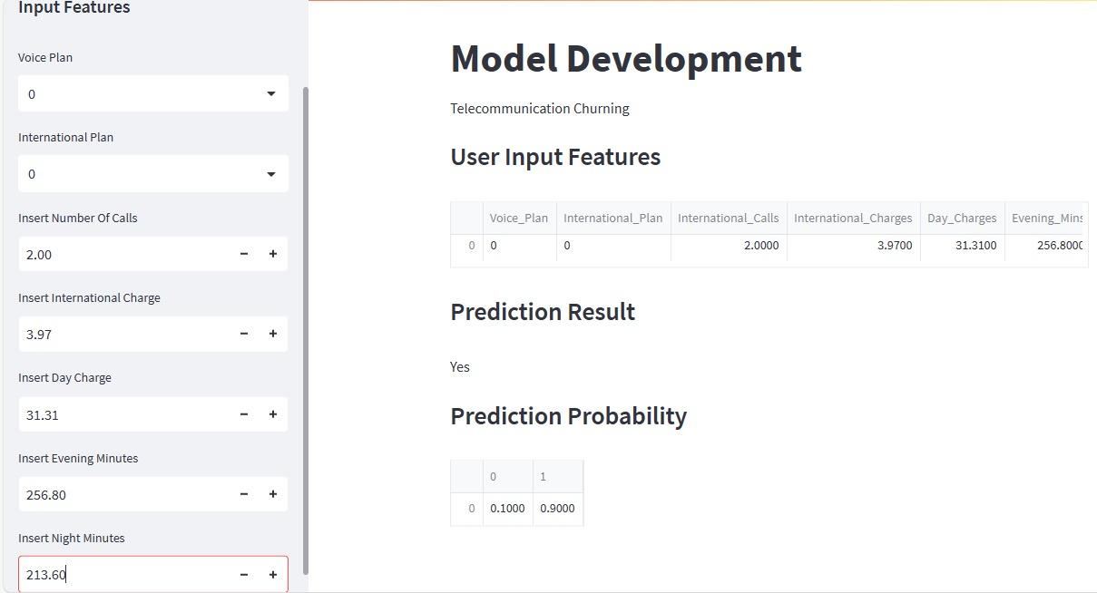
Deployment Prediction 1
Key Insights:
Input Features:
Input features were provided based on the dataset.
Both the Voice Plan and International Plan inputs were set to "No," represented by 0.
Other Numerical Features:
The remaining features were taken from a specific row in the dataset as numerical inputs.
Prediction Output:
Upon execution, the model predicted the outcome.
In this specific case, the prediction is "Churn" with a high prediction probability of 90%.
These insights demonstrate how the model responds to specific input values, allowing users to assess the likelihood of churn based on the provided inputs.

Slide 36
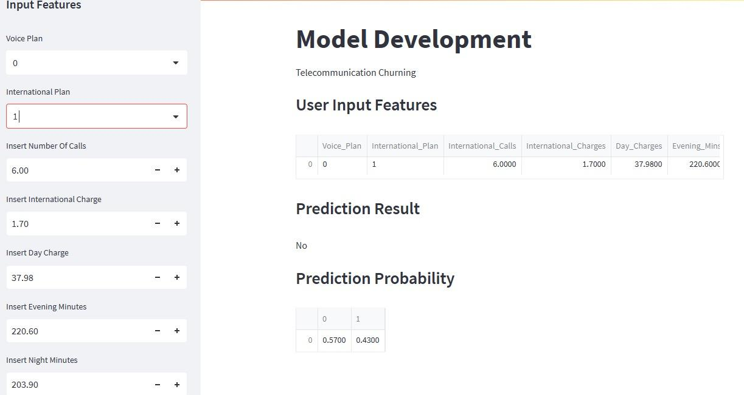
Deployment Prediction 2
Input Features:
Input features were provided based on the dataset.
The Voice Plan input was set to "No" (0), while the International Plan input was set to "Yes" (1).
Other Numerical Features:
The remaining features were taken from a specific row in the dataset as numerical inputs.
Prediction Output:
Upon execution, the model predicted the outcome.
In this specific case, the prediction is "No Churn" with a prediction probability of 43%.
Thank you

